Slide 1
Analysis on Canada emergency wage subsidy
Present by: MT Team
Team member: Chuhong He
Hanwen Cao
Rui Xu
Yiming Yu

Slide 2
Our Targets
How Wage Subsidy were given to the different Industries
How this Subsidy affect CPI(Consumer Price Index) and Unemployment Rate

Slide 3
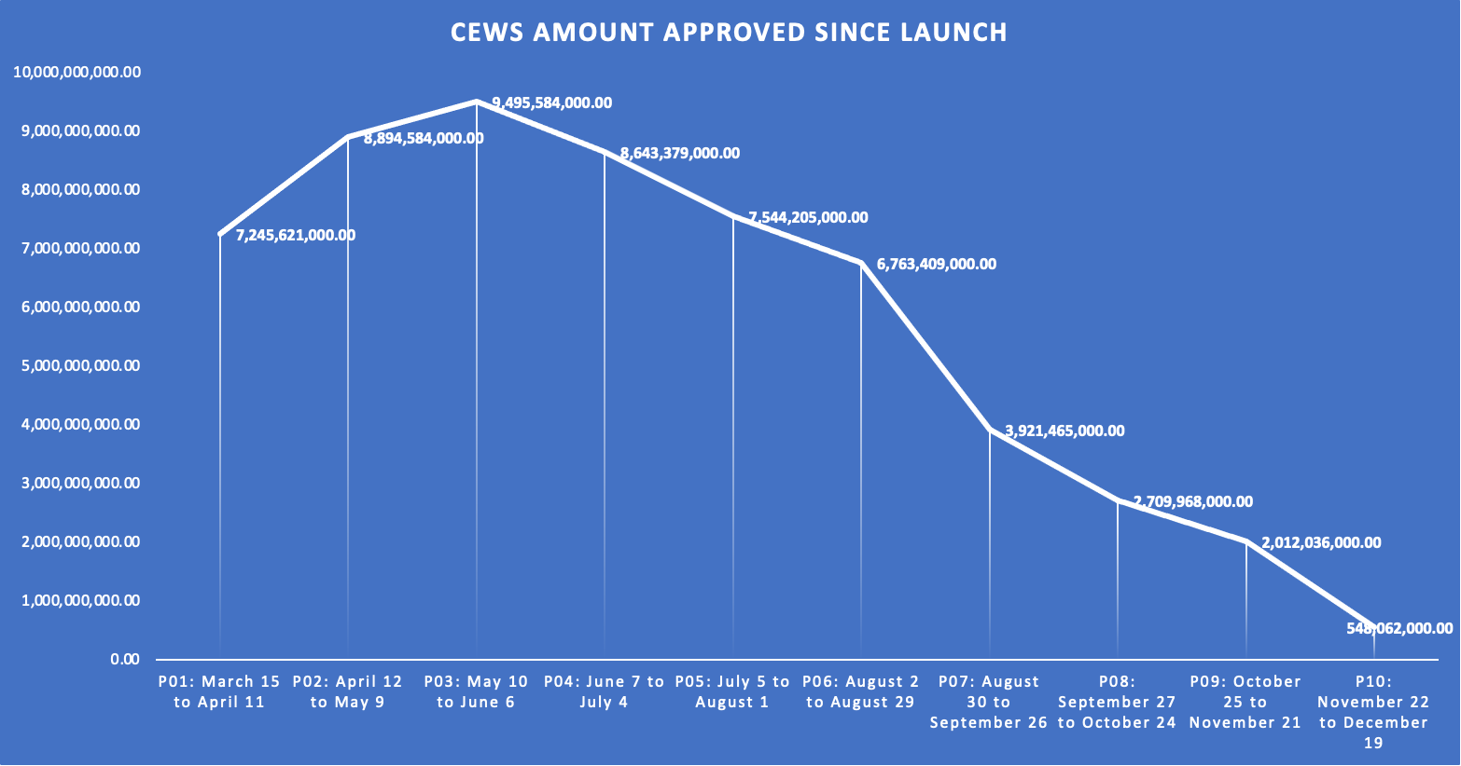

Slide 4
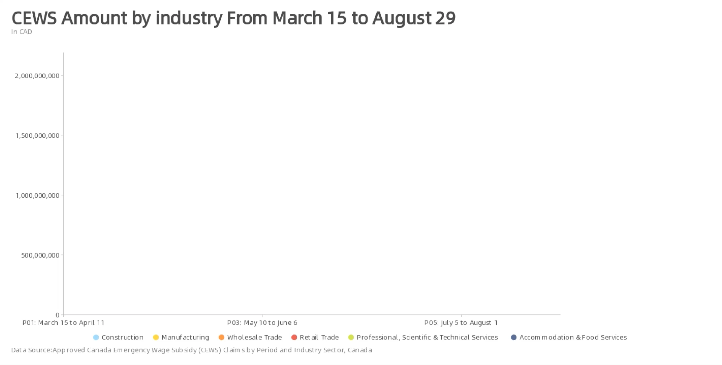

Slide 5
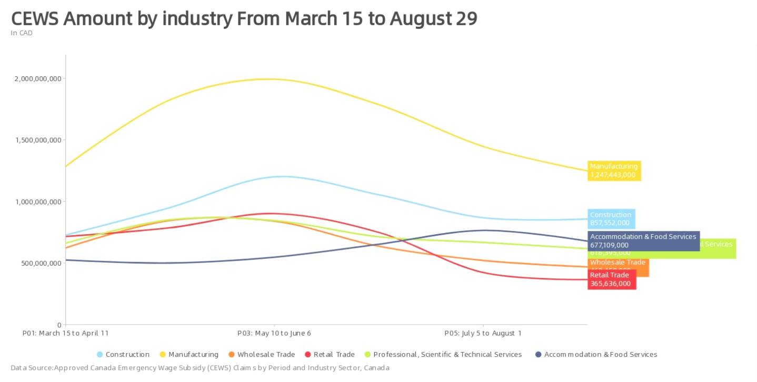

Slide 6
Impacts on CPI and Unemployment

Slide 7
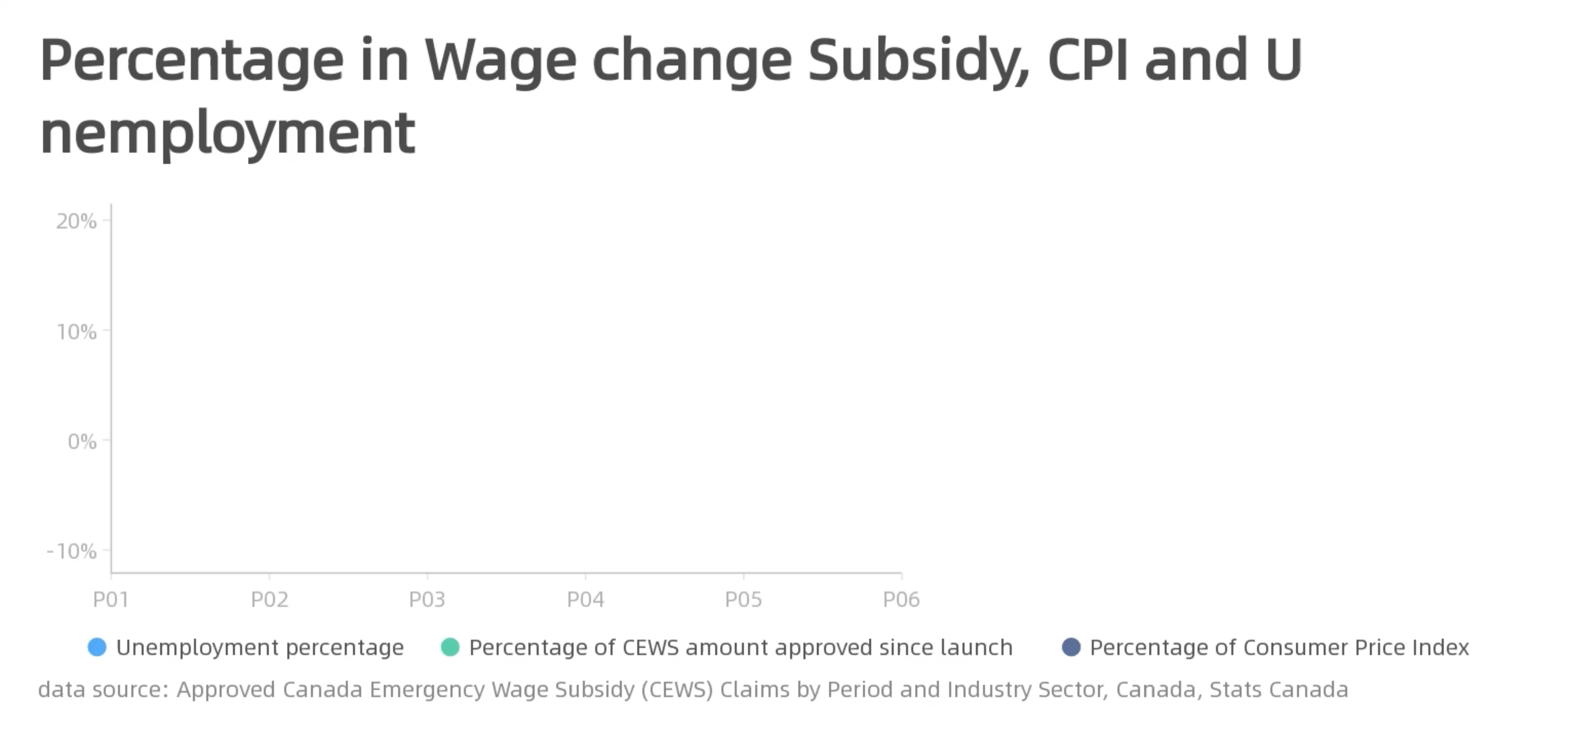

Slide 8
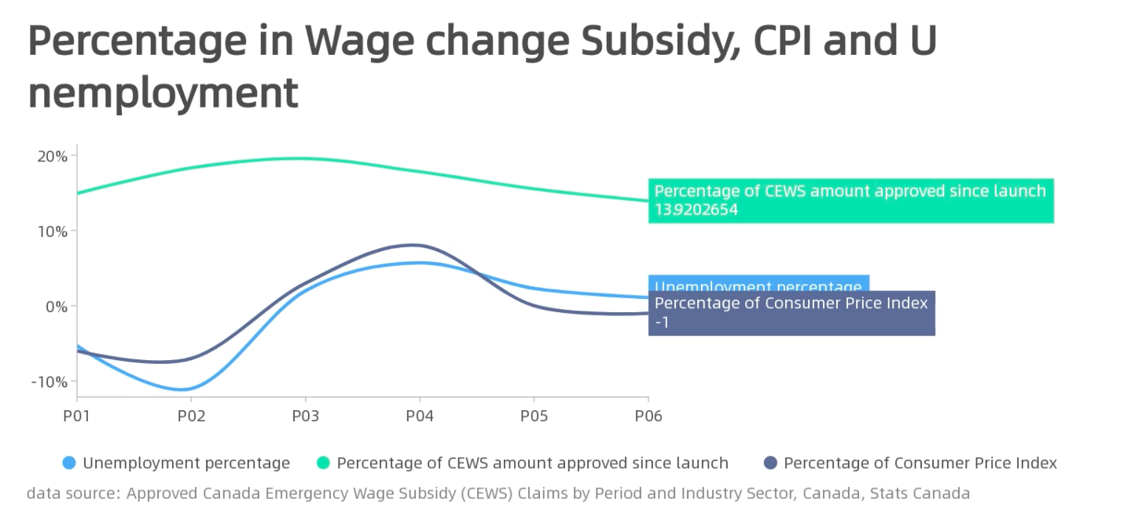

Slide 9
Reference
Table 2: Approved Canada Emergency Wage Subsidy (CEWS) Claims by Period and Industry Sector, Canada https://www.canada.ca/content/dam/cra-arc/serv-info/tax/business/topics/cews/statistics/cews_tbl2.pdf
https://open.canada.ca/data/en/dataset/f713389f-ab1c-4be4-bade-05f71ed110fe/resource/be781fe5-a632-4cec-a7ba-82ec92e5a35b
https://www150.statcan.gc.ca/n1/daily-quotidien/220119/dq220119a-eng.htm?HPA=1&indid=3665-1&indgeo=0
https://www150.statcan.gc.ca/n1/daily-quotidien/220204/dq220204a-eng.htm?HPA=1&indid=3587-2&indgeo=0
https://dycharts.com

Slide 10
Thanks for watching

